Slide 1
DESIGN (ANTI-)PATTERNS
Facade

Slide 2
WHAT ARE DESIGN PATTERNS
A software design pattern is a general, reusable solution to a commonly occurring problem. It is not a finished design that can be transformed directly into source or machine code. It is a description or template for how to solve a problem that can be used in many different situations. Design patterns are formalized best practices that the programmer can use to solve common problems when designing an application or system.
Types
Creational (singleton, builder, lazy init, abstract factory, object pool etc.)
Structural (adapter, bridge, decorator, facade, composite, proxy etc.)
Behavioral (iterator, strategy, template method, visitor, command, memento etc.)
Concurrency (thread pool, double checked locking, monitor object, reactor etc.)

Slide 3
Facade
Dušan Marko

Slide 4
Facade
GoF Definition
Provide a unified interface to a set of interfaces in a subsystem. Facade Pattern defines a higher-level interface that makes the subsystem easier to use.

Slide 5
Facade
GoF Definition
Provide a unified interface to a set of interfaces in a subsystem. Facade Pattern defines a higher-level interface that makes the subsystem easier to use.
When is the Facade pattern used?
A simple interface is required to access a complex system.
A system is very complex or difficult to understand.
An entry point is needed to each level of layered software.
The abstractions and implementations of a subsystem are tightly coupled.

Slide 6
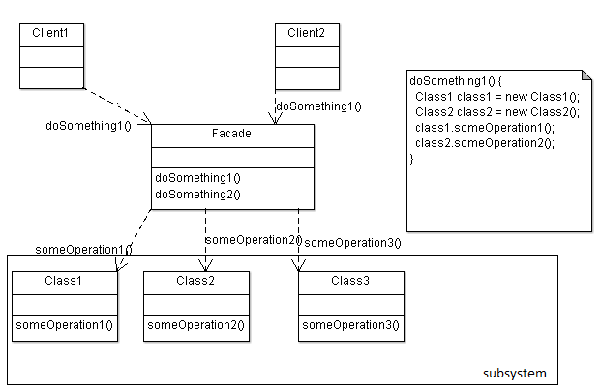
Facade
Participants
Client
calls only facade methods, no susbystems
Facade
knows which subsystems are responsible for a request
delegates client requests to appropriate subsystem objects
Subsystem
implements specialized functionality
no knowledge of or reference to the facade

Slide 7
Facade
Examples in core Java libs
javax.faces.context.FacesContext uses LifeCycle, ViewHandler, NavigationHandler classes under the hood, but most clients aren’t aware of that.
javax.faces.context.ExternalContext uses ServletContext, HttpSession, HttpServletRequest, HttpServletResponse and others inside.
javax.swing.JOptionPane uses Dialog, Layout, JPanel, etc.
Other examples
Customer service (facade for ordering system : Order Fullfillment, Billing, Shipping)

Slide 8
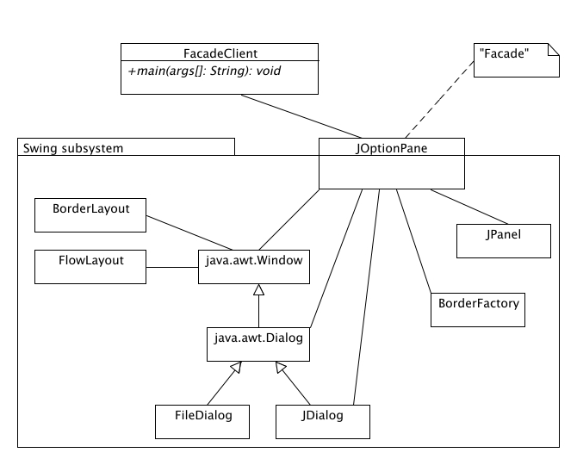
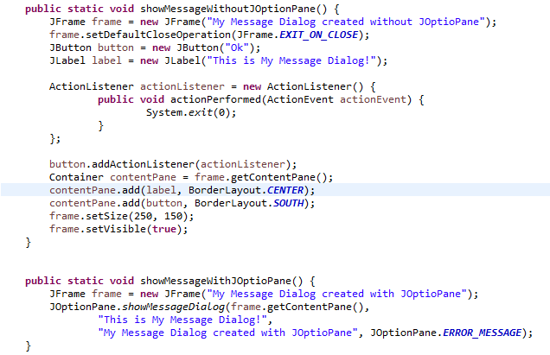
Facade
Example JOptionPane

Slide 9
Facade
Demo

Slide 10
Facade
Benefits
easier for the client to use
easier to refactor without affecting the client
Best practice
Do not create monolithic monster object (called also God Object)
Facade's implementation should be very light
simply forward to other objects
Act as a "Traffic cop"

Slide 11
Facade
Related Patterns
Abstract Factory can be used with Facade to provide an interface for creating subsystem objects.
Facades are often implemented as Singletons when only one facade per subsystem is needed/desired.
Mediator is similar to Facade in that in abstracts functionality of existing classes. [GoF, "Design Patterns"]. However while a Mediator centralizes functionality which doesn't belong in its colleague objects, a Facade does not define new functionality and the subsystems classes don't need to know anything about the facade object(s).
Facade is very similar to Adapter, they are both wrappers and while you will often find facades wrapping multiple objects and adapters wrapping single objects, keep in mind this is not the difference between them.The intent of Facade is to produce a simpler interface, and the intent of Adapter is to design to an existing interface. [Alan Shalloway and James Trott, "Design Patterns Explained"]

Slide 12
Facade
References
Design Patterns in Java™, Second Edition by William C. Wake; Steven John Metsker
https://learning.oreilly.com/library/view/design-patterns-in/9780321630483/ch04.html
Design Patterns in Java by Petter Graff
https://learning.oreilly.com/videos/design-patterns-in/9781771374040/9781771374040-video215003
https://refactoring.guru/design-patterns/facade/java/example
https://sourcemaking.com/design_patterns/facade
https://www.geeksforgeeks.org/facade-design-pattern-introduction/
http://best-practice-software-engineering.ifs.tuwien.ac.at/patterns/facade.html

Slide 13
Facade
Questions and discussion

